Slide 1
Object Oriented Programming using Java
SUKKUR IBA UNIVERSITY
Presented By:
Ghulam Mujtaba Shaikh

Slide 2
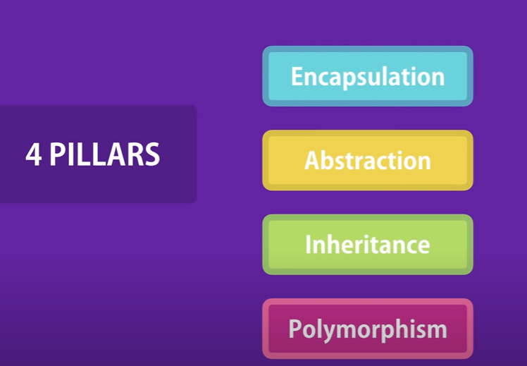
Pillars of Object-Orientation

Slide 3

Encapsulation

Slide 4
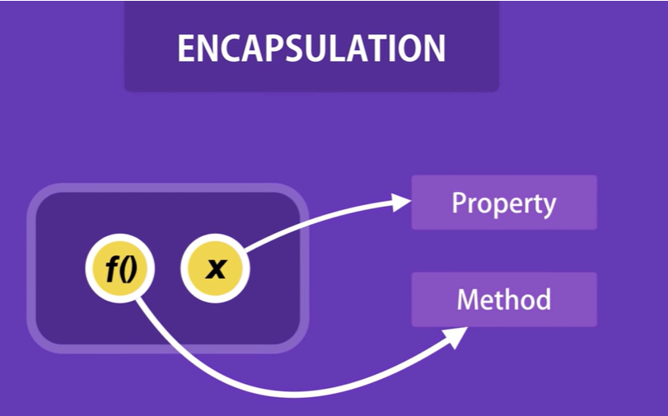
Encapsulation

Slide 5
Encapsulation
We enclose or encapsulate related methods and properties in one unit.
This phenomena is known as encapsulation
To hide the data using access modifiers
  Public
  Private
  Protected

Slide 6
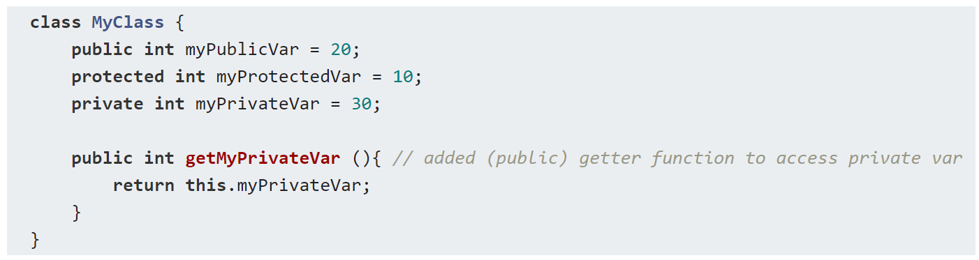
Encapsulation- Example

Slide 7
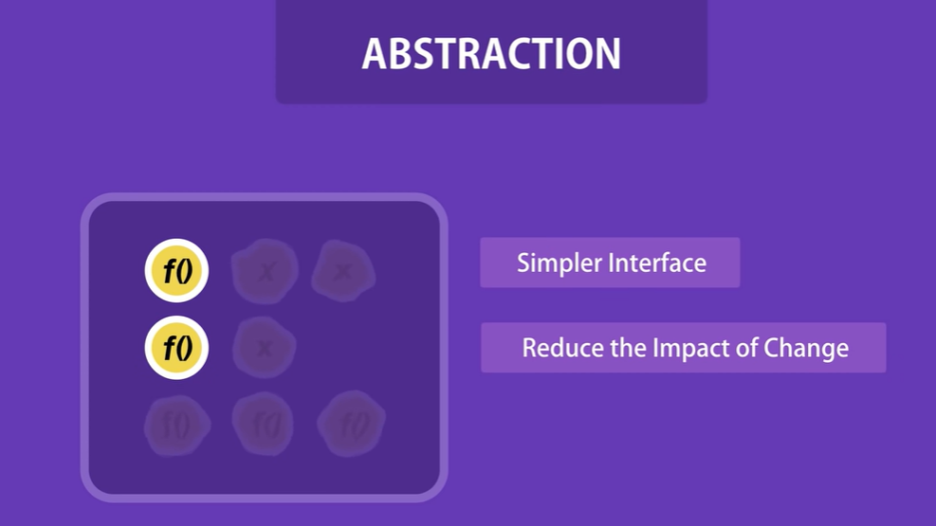
Abstraction
Hide the complexity.
Abstraction means displaying only essential information and hiding the details.
Separate the interface and implementation
Data versus Process level abstraction

Slide 8
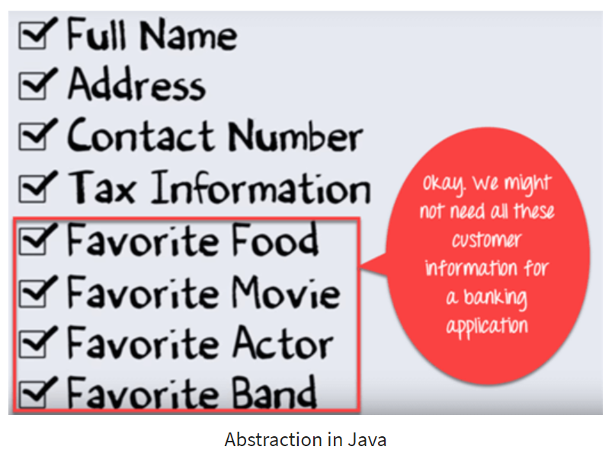
Data Level Abstraction

Slide 9
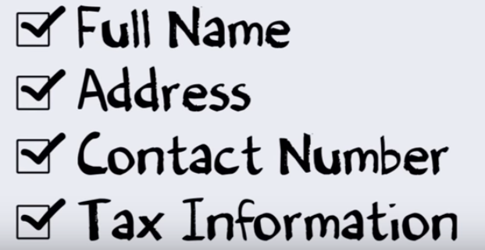
Data Level Abstraction

Slide 10
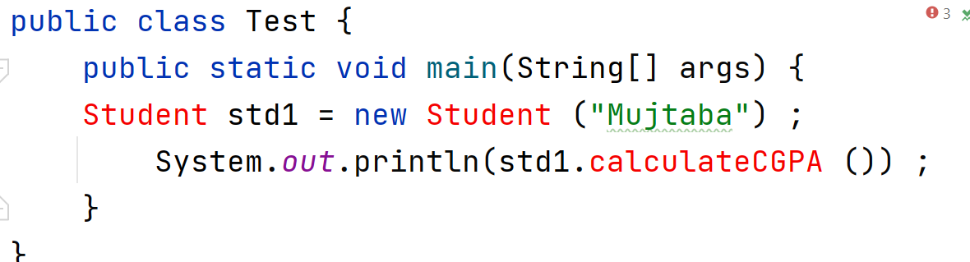
Process Level Abstraction

Slide 11
Process Level Abstraction
Abstraction is a design level process and it is used to reduce the complexity at the designing stage of a project.
Encapsulation is an implementation level process, and it is used to provide privacy and maintain control over the transparency of data at the implementation stage of a project.

Slide 12
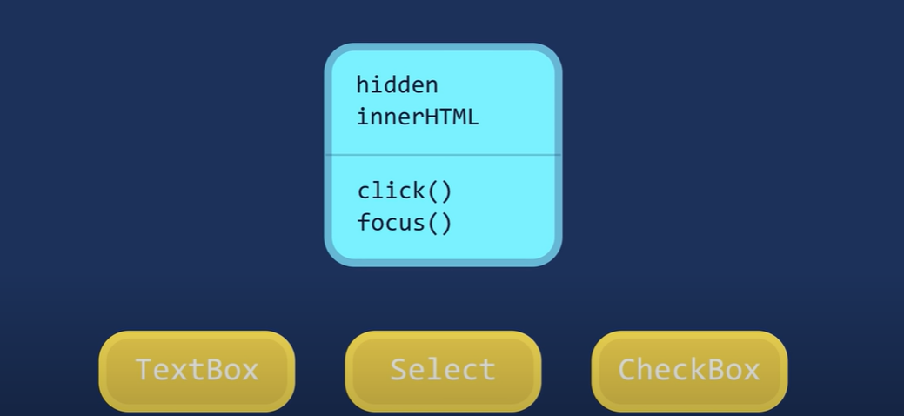
Inheritance
A child inherits characteristics of its parents
Besides inherited characteristics, a child may have its own unique characteristics

Slide 13
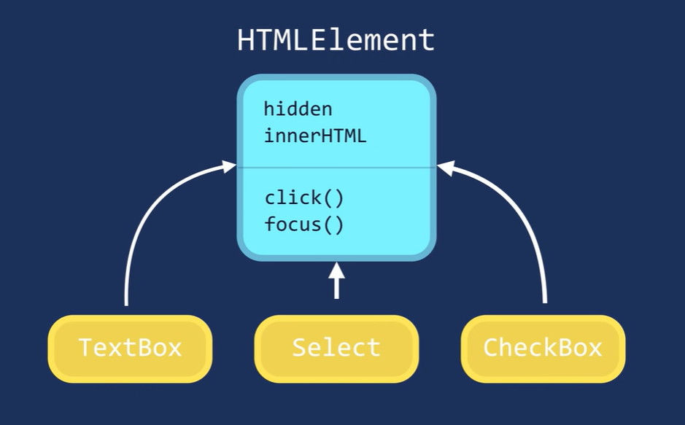
Inheritance
A child inherits characteristics of its parents
Besides inherited characteristics, a child may have its own unique characteristics

Slide 14
Inheritance – “IS A” or
“IS A KIND OF” Relationship
Each derived class is a special kind of its base class

Slide 15
Example – “IS A” Relationship
Person
name
age
gender
eat
walk
Student
Teacher
Doctor
program
studyYear
designation
salary
designation
salary
study
heldExam
teach
takeExam
checkUp
prescribe

Slide 16
Inheritance – Advantages
Reuse
Less redundancy
Increased maintainability

Slide 17

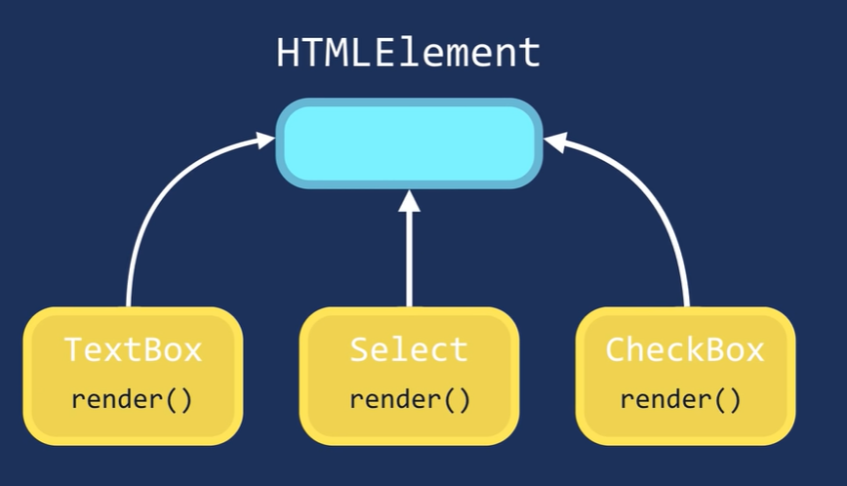
Polymorphism

Slide 18
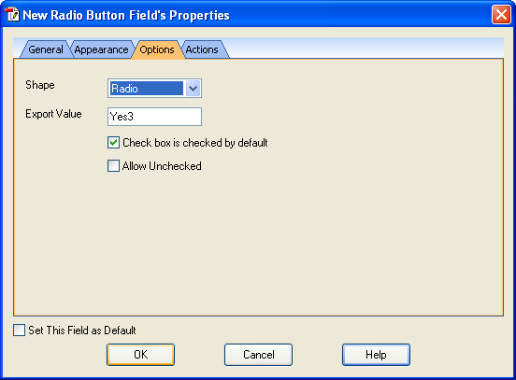
Polymorphism

Slide 19
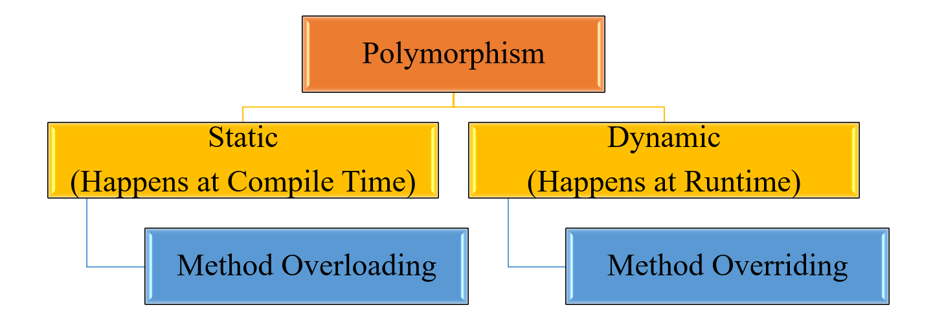
Polymorphism

Slide 20
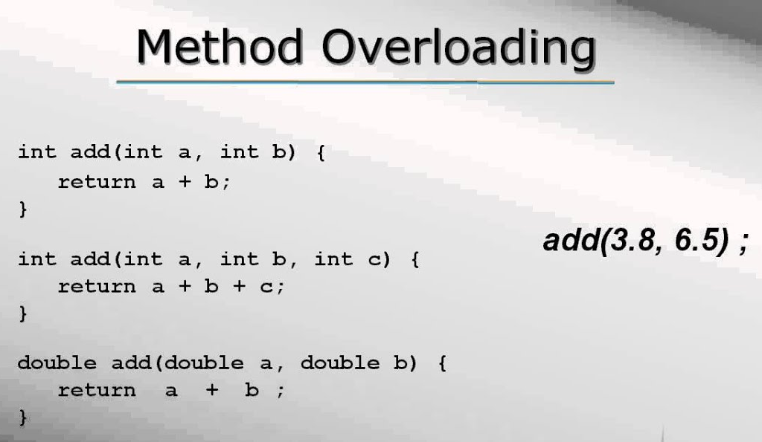
Polymorphism

Slide 21
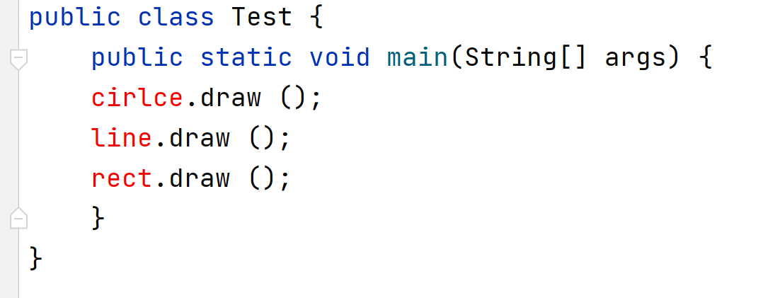
Polymorphism

Slide 22
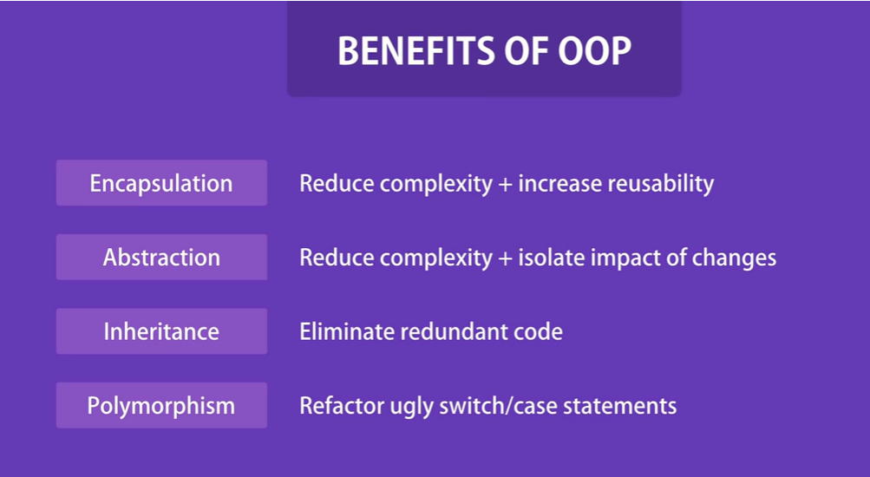
Polymorphism

Slide 23
Association
Objects in an object model interact with each other
Usually an object provides services to several other objects
An object keeps associations with other objects to delegate tasks

Slide 24
Kinds of Association
Class Association
  Inheritance
Object Association
  Simple Association
  Composition
  Aggregation

Slide 25
Simple Association
Is the weakest link between objects
Is a reference by which one object can interact with some other object
Is simply called as “association”
Ali lives in a house.

Slide 26
Composition
An object may be composed of other smaller objects
The relationship between the “part” objects and the “whole” object is known as Composition
Composition is represented by a line with a filled-diamond head towards the composer object

Slide 27
Example – Composition of Ali
Head
1
Arm
Ali
Leg
2
2
1
Body
Notes:
Head
State: Eyes, Nose, Mouth, Ears, Hair
behaviour: Look, Sniff, Eat, Listen
Body
State: Waist, Chest Width, Shape
behaviour: Digest Food, Circulates Blood, Respiration
Arms
State: Hands, Fingers, Nails
behaviour: Move, Hold, Stretch
Legs
State: Feet, Fingers, Nails
behaviour: Walk, Turn, Stop

Slide 28
Composition is Stronger
Composition is a stronger relationship, because
  Composed object becomes a part of the composer
  Composed object can’t exist independently

Slide 29
Example – Composition is Stronger
Ali is made up of different body parts
They can’t exist independent of Ali

Slide 30
Aggregation
An object may contain a collection (aggregate) of other objects
The relationship between the container and the contained object is called aggregation
Aggregation is represented by a line with unfilled-diamond head towards the container

Slide 31
Example – Aggregation
Bed
1
Chair
Room
Table
*
1
1
Cupboard

Slide 32
Aggregation is Weaker
Aggregation is weaker relationship, because
  Aggregate object is not a part of the container
  Aggregate object can exist independently

Slide 33
Recap
Four Pillars of OOP
  Encapsulation
  Abstraction
  Inheritance
  Polymorphism

